Slide 1
A Progress Update

Slide 2
Linear Regression
We made a linear regression matrix using multiple multivariable regressions.
After testing it on the Total Lean Mass, it had an average relative error of 6.58% with a standard deviation of 6.34%.
Through a heuristic approach, we concluded that the variables Age, Height, Weight, Inseam Left, Inseam Right, and Waist Circumference contributed the most.
Average relative error- 7.82%
Standard deviation- 6.12%
Using an SVD approximation of the linear regression matrix using 18 Singular Values
Average relative error - 7.037%
Standard Deviation of Relative Error - 5.43%
Standard Deviation of Lean Mass - 15.654 units

Slide 3
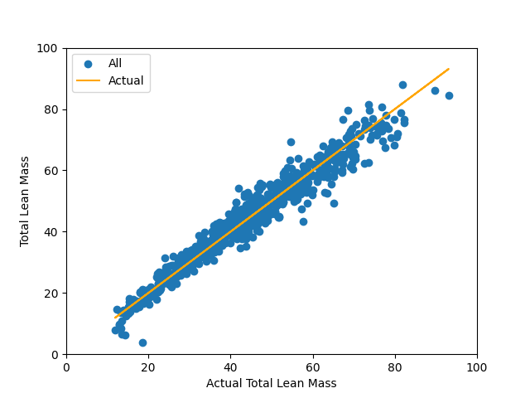
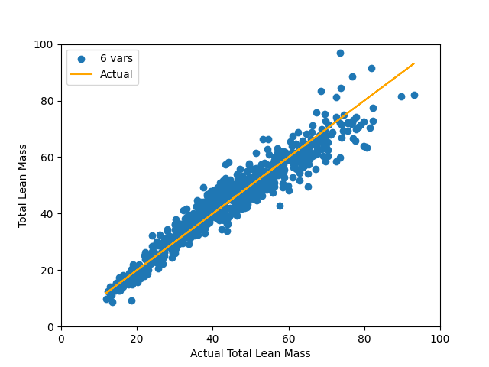
Charts
Chart 1 represents what happens when we plot the actual lean mass is up against the estimated lean mass using all variables. If a value is above the orange line, it is an overestimate. If a value is under the line, it is an underestimate.
Chart 2 is the same as Chart 1 except we use the 6 variables specified in the previous slide which are Age, Height, Weight, Inseam Left, Inseam Right, and Waist Circumference.

Slide 4
Variables
Age
Height
Weight
Inseam Left
Inseam Right
Waist Circumference

